Slide 1
Naïve Baye’s Theorem

Slide 2
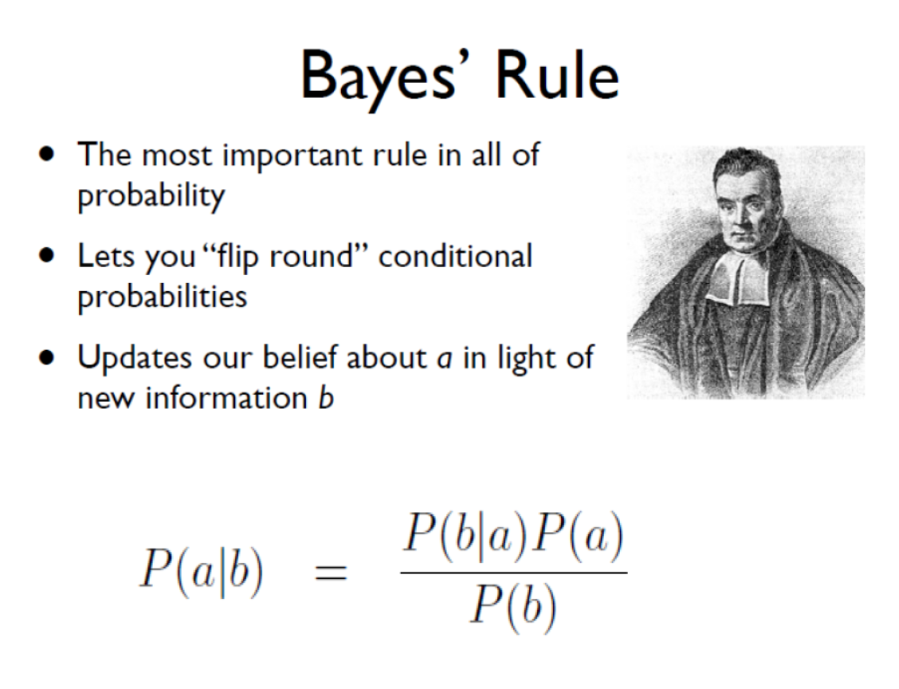

Slide 3
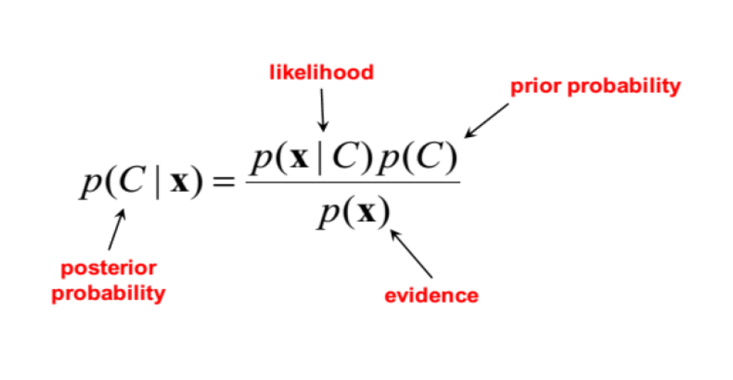

Slide 4
Naïve Baye’s Theorem
Naïve Baye’s theorem is a supervised learning algorithm
Naïve Baye’s algorithm is based on Naïve assumption of independence b/w every pair of features.
Given class variable Morning Work Out(y) and dependent feature vector of Morning Breakfast thru……….Night Dinner(x1, x2……xn).

Slide 5
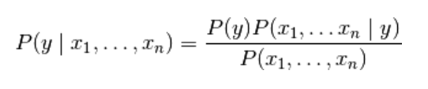
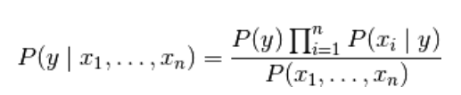
Naïve Baye’s Theorem
Baye’s theorem states the above as follows:
Above same theorem can be generalised as:

Slide 6
Partial Fit
Naive Bayes models can be used to tackle large scale classification problems for which the full training set might not fit in memory.
To handle this case GaussianNB , BernoulliNB and MultinomialNB expose a partial_fit method that can be used incrementally.

